Slide 1
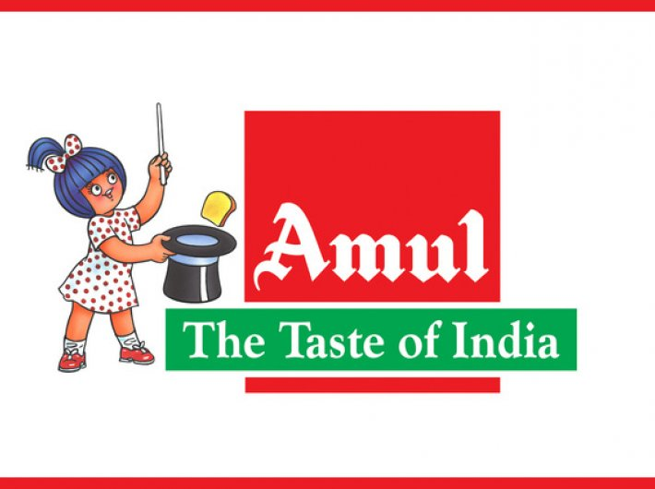
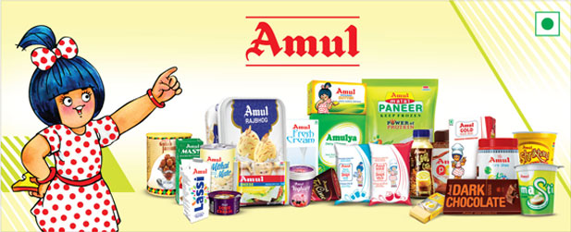
TEAM PROJECT WORK
AMUL
THE TASTE OF INDIA

Slide 2
GROUP MEMBERS & UNIVERSITY NAME
GROUP MEMBERS
1)Team Lead Member :- B.MOUNIKA
2) Member 1 :- S.NASEEMA
3)Member 2 :- G.BHAVYA SREE
4) Member 3 :- P.JAYASREE
5) Member 4 :- P.BHUVANA SRI
UNIVERSITY NAME
SRI VENKATESHWARA UNIVERSITY ( SVU )
GOVT. DEGREE COLLEGE FOR WOMEN MADANAPALLE

Slide 3
DECLARATION
I, P.JAYASREE here by declare that the project work entitled “COMPREHENSIVE DIGITAL MARKETING FOR AMUL " is my project.
This project is my original work and have not been published and presented any where earlier. The analysis of this project is done by me in the
supervision of Dr. V. Gurumurthy, Lecturer in Zoology and findings
are obtained by rigorous methods used and the best of my knowledge.

Slide 4
ACKNOWLEDGEMENT
This study even internal part of our VI SEMISTER BSC(B.Z.C) program and to do this project . In a long term internship with my Intention, dedication, concentration and hard work are very much essential to complete our task. I bear to imprint of my people who have given me their precious ideas and times to enable me to complete the project report. I want to thank them for their continuous support at our project and writing efforts. First of all I would like to thank Dr. V.Gurumurthy, Lecturer in Zoology GOVT. DEGREE COLLEGE FOR WOMEN MADANAPALLE, for giving me an opportunity to
write my Dissertation report under his guidance and supervision and for all the
help and support which led me complete the project.

Slide 5
INDEX
SL.NO | TOPICS | Pg.NO
1 | INTRODUCTION | 1-3
2 | COMPANY INFORMATION | 4
3 | COMPANY PROFILE OF AMUL | 5-6
4 | PRODUCT LIFE CYCLE STAGES | 7-9
5 | PRODUCT RANGE | 10-14
6 | AMUL’S TARGET AUDIENCE | 15
7 | AMUL’S MARKETING CAMPAIGNS & STRATEGY | 16-17
8 | AMUL’S ADS FOR INSTAGRAM | 18
9 | AMUL’S ADS FOR FACEBOOK | 18

Slide 6
SL.NO | TOPICS | Pg.NO
10 | NATIONAL MILK DAY CAMPAIGN | 19
11 | AMUL’S ON TWITTER | 20
12 | AMUL’S ON YOUTUBE | 21
13 | EMAIL MARKETING & LINKEDIN | 22
14 | AMUL’S DIGITAL MARKETING STRATEGIES DURING COVID -19 | 23
15 | AMUL MARKETING STRATEGIES | 24-25
16 | CONCLUSION | 26

Slide 7
INTRODUCTION
AMUL (Anand Milk Union Limited), formed in 1946, is a dairy cooperative movement in
India. It is a brand name managed by an apex cooperative organization, Gujarat Co-operative
Milk Marketing Federation Lt. (GCMMF), which today is jointly owned by some 2.6 million
milk producers in Gujarat, India.
AMUL is based in Anand, Gujarat and has been a sterling example of a co-operative
organization's success in the long term. It is one of the best examples of co-operative
achievement in the developing world.
The Amul Pattern has established itself as a uniquely appropriate model for rural development.
Amul has spurred the White Revolution of India, which has made India.
The largest producer of milk and milk products in the world. It is also the world's biggest vegetarian cheese brand.

Slide 8
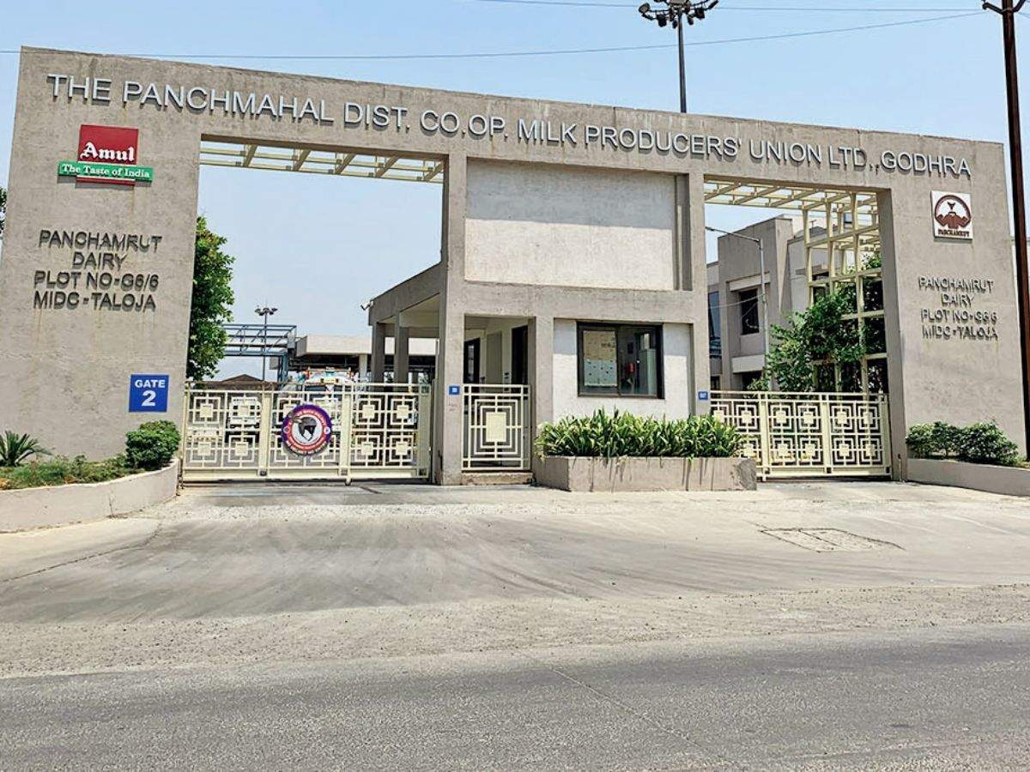
Amul is the largest food brand in India and world's Largest Pouched Milk Brand with an annual turnover of US $1050 million (2006-07). Currently Amul has 2.6 million producer members with milk collection average of 10.16 million litres per day. Besides India, Amul has entered overseas markets such as Mauritius, UAE, USA, Bangladesh, Australia, China, Singapore, Hong Kong and a few South African countries. Its bid to enter Japanese market in 1994 had not succeeded, but now it has fresh plans of flooding the Japanese markets. Other potential markets being considered include Sri Lanka.

Slide 9
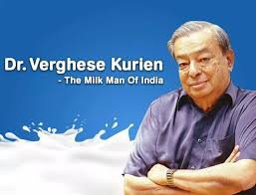
Dr Verghese Kurien, former chairman of the GCMMF, is recognized as the man behind the success
of Amul. On 10 Aug 2006 Parthi Bhatol, chairman of the Banaskantha Union,
was elected chairman of GCMMF. Who is known as the milk man of india
He left his government job and decided to join Tribhuvandas Patel and Morarji Desai who were trying to unite the farmers and form a cooperative movement against exploitation.
They hence started the Milk Cooperative movement “Kaira District Cooperative Milk Producers Union Ltd”, which was later renamed “Amul”.

Slide 10
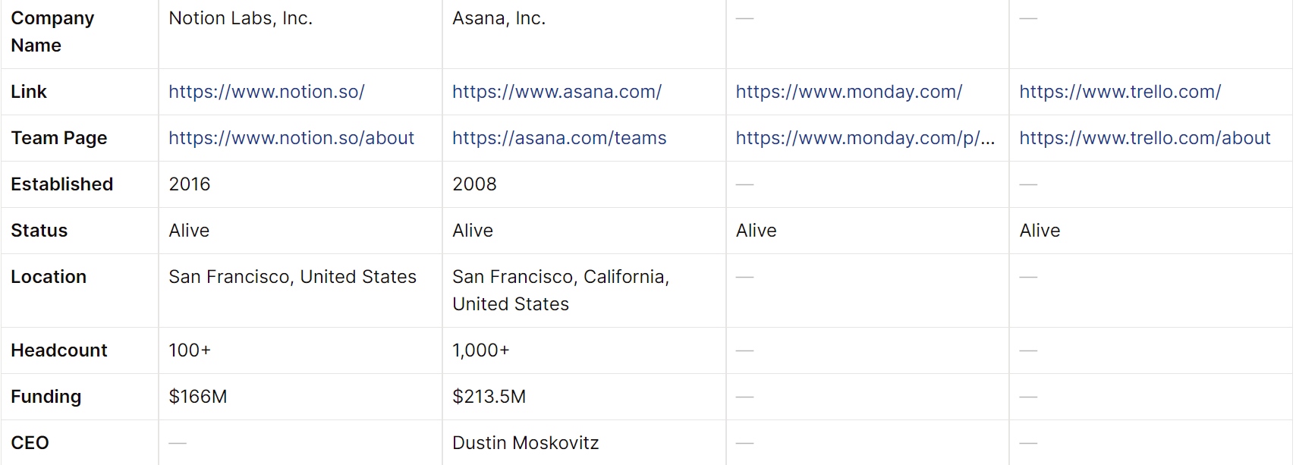
COMPANY INFORMATION

Slide 11
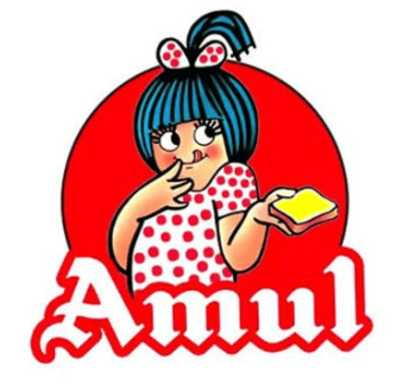
COMPANY PROFILE OF AMUL
The mighty Ganges at its origin is but a tiny stream in the Gangotri ranges of the Himalayas. Similar is the story of Amul which inspired Operation Flood and heralded the 'White Revolution' in India.
AMUL means "priceless" in Sanskrit. The brand name "Amul," from the Sanskrit "Amoolya," was suggested by a quality control expert in Anand. Variants, all meaning "priceless", are found in several Indian languages. Amul products have been in use in millions of homes since 1946. Amul Butter, Amul Milk Powder, Amul Ghee, Amulspray, Amul Cheese, Amul Chocolates, Amul Shrikhand, Amul Ice cream, Nutramul, Amul Milk and Amulya have made Amul a leading food brand in India. (Turnover: Rs. 52.55 billion in 2007-08). Today Amul is a symbol of many things. Of high-quality products sold at reasonable prices. 50 years after it was first launched, Amul's sale figures have jumped from 1000 tonnes a year in 1966 to over 25,000 tonnes a year in 1997. No other brand comes even close to it.
AMUL stands for
A = Anand
M = Milk
U = Union
L = Limited

Slide 12
Amul (Anand milk union ltd.) is abased on four hands, which are coordinated with each other. The actual meaning of this symbol is co-ordination of four hands of different people by whom this union is at the top position in Asia.
First hand is of farmers, without whom the organization would not have existed.
Second hand is of processors, who process the row material (milk)into finished goods .
Third hand is of marketer, without whom the product would have not reached the customers.
Fourth hand is of customers, without whom the products would have not carried on.

Slide 13
PRODUCT LIFE CYCLE STAGES
A product passes through distinct stages during its life in market, each posing different challenges, opportunities and problems .Profits rise and fall at different stages of the product life cycle. There are four different stages of product life cycle, namely
INTRODUCTION STAGE
GROWTH STAGE
MATURITY STAGE
DECLINE STAGE
Different products of AMUL are in different stages in the product life cycle. Products like milk, butter, chocolate and cheese are in the maturity stage, while ice-creams , chocolates and shrikhand are still in the growth stage. On the other hand, products like milk powders, infant food, frozen food items and mix are in introduction stage.
The company adopts aggressive selling techniques for those products which are in the introductory stage, while very less promotional programmes are carried out for those products which are in the growth or maturity stage.

Slide 14
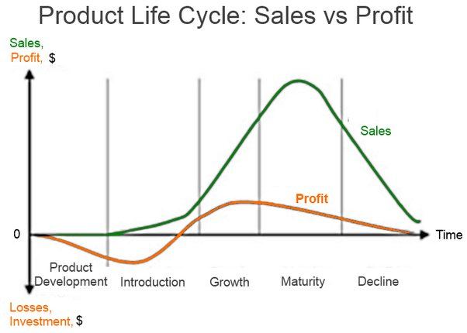

Slide 15
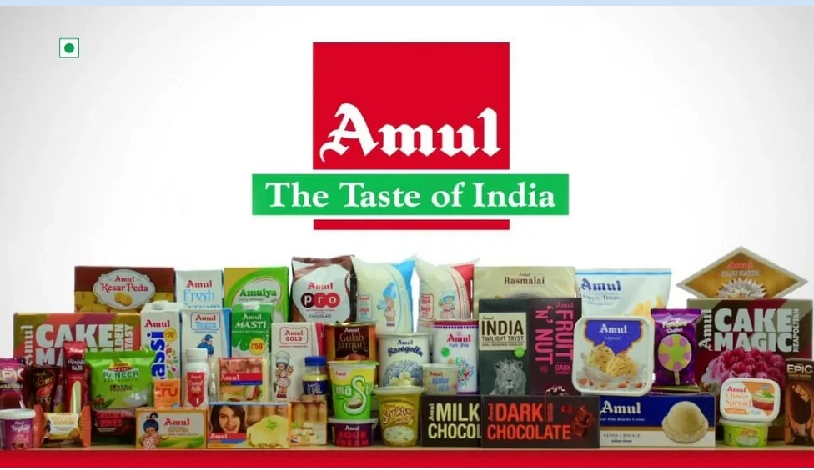
AMUL PRODUCTS

Slide 16
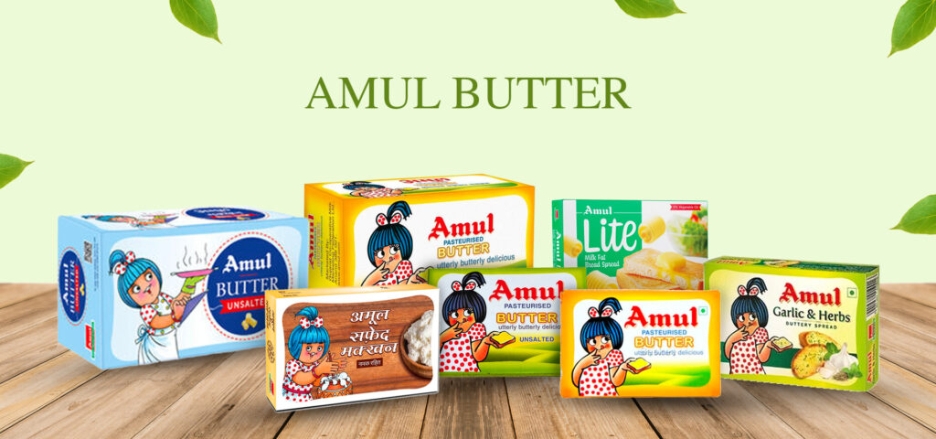
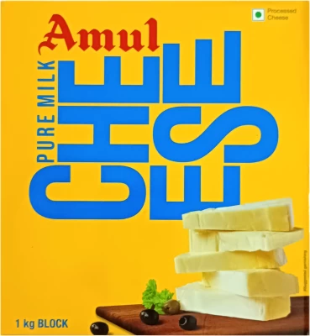
PRODUCT RANGE
A vast varieties of products are offered by AMUL which are as follows:
BREADSPREADS
Amul Butter
Amul Lite Low Fat Breadspread
Amul Cooking Butter
CHEESE RANGE
Amul Pasteurized Processed Cheddar Cheese
Amul Processed Cheese Spread
Amul Pizza (Mozarella) Cheese
Amul Shredded Pizza Cheese
Amul Emmental Cheese
Amul Gouda Cheese
Amul Malai Paneer (cottage cheese)
Frozen and Tinned Utterly Delicious Pizza

Slide 17
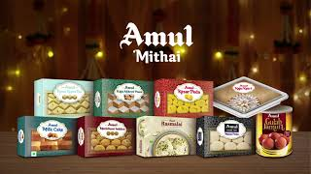
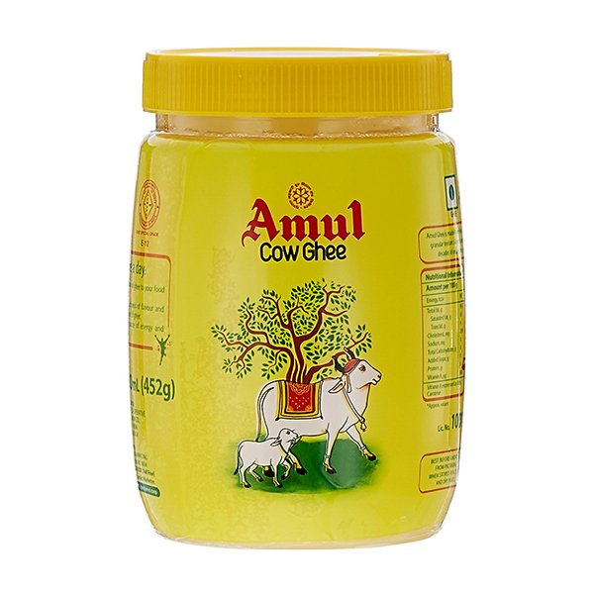
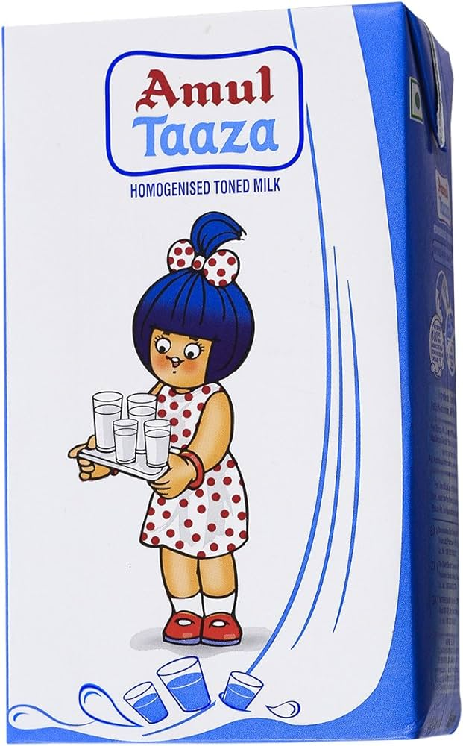
MITHAEE RANGE ( ETHNIC SWEETS)
Amul Shrikhand ( Mango ,Saffron, Almond Pistachio, Cardamom)
Amul Amrakhand
Amul Mithaee Gulabjamuns
Amul Mithaee Gulabjamun Mix Amul Mithaee Kulfi Mix
PURE GHEE
Amul Pure Ghee
Sagar Pure Ghee
Amul Cow Ghee
INFANT MILK RANGE
Amul Infant Milk Formula 1 (0-6 months)
Amul Infant Milk Formula 2 ( 6 months above)
Amulspray Infant Milk Food

Slide 18
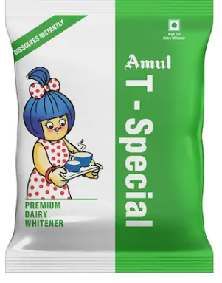
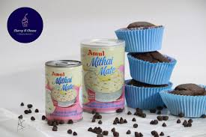
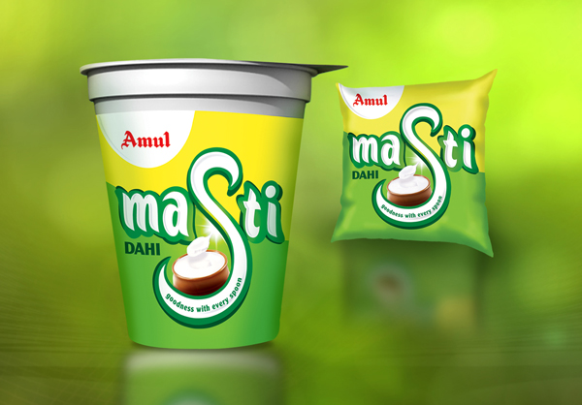
MILK POWDERS
Amul Full Cream Milk Powder
Amulya Dairy Whitener
Sagar Skimmed Milk Powder
Sagar Tea and Coffee Whitener
SWEETENED CONDENSED MILK
Mithaimate Sweetened Condensed Milk
FRESH MILK
Amul Taaza Toned Milk 3% fat
Amul Gold Full Cream Milk 6% fat
Amul Shakti Standardised Milk 3% fat
Amul Smart Double Toned Milk 1.5% fat
CURD PRODUCTS
Amul Masti Dahi (fresh curd)
Amul Butter Milk
Amul Lassi

Slide 19
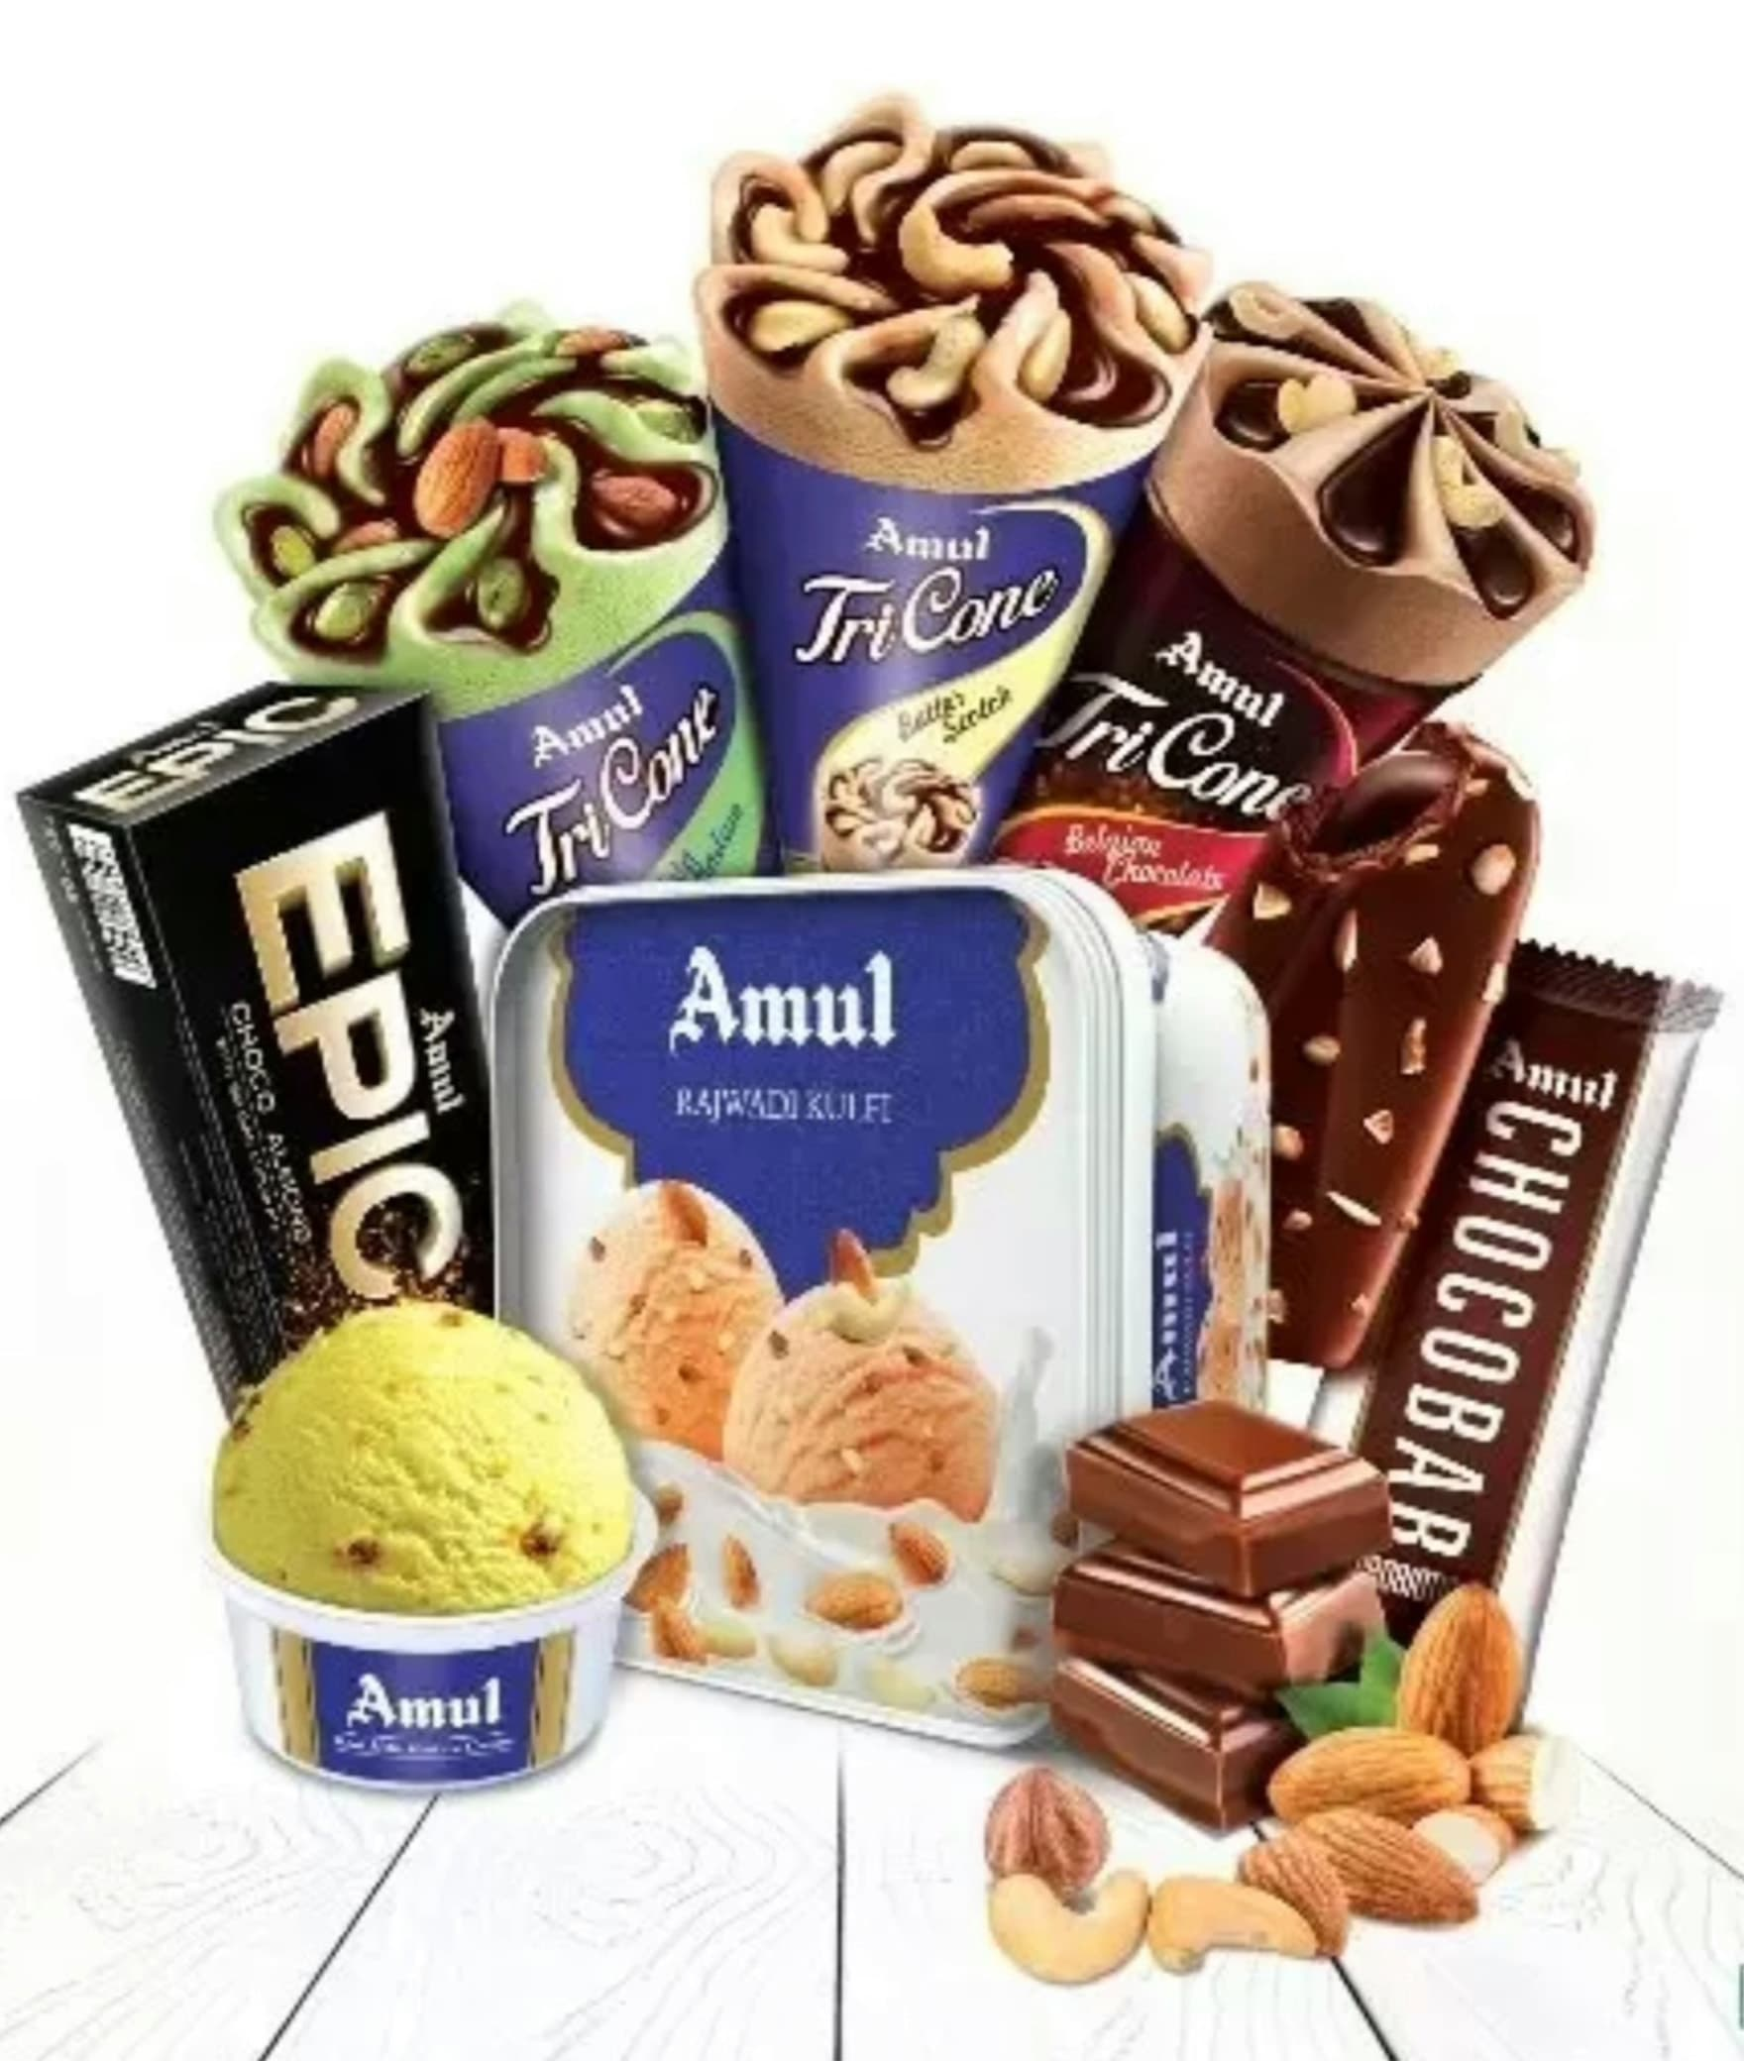
AMUL ICECREAMS
• Royal Treat Range (Rajbhog, Cappuchino, Chocochips, Butterscotch, Tutti Frutti)
• Nut-o-Mania Range (Kaju Drakshi, Kesar Pista, Roasted Almond, Kesar Carnival, Badshahi Badam kulfi, Shista Pista Kulfi)
• Utsav Range (Anjir, Roasted Almond)
• Simply Delicious Range (Vanilla, Strawberry, Pineapple, Rose, Chocolate)
• Nature's Treat (Alphanso Mango, Fresh Litchi, Anjir, Fresh Strawberry, Black Currant)
• Sundae Range (Mango, Black Currant, Chocolate, Strawberry) • Millennium Icecream (Cheese with Almonds, Dates with Honey)
• Milk Bars (Chocobar, Mango Dolly, Raspberry Dolly, Shahi Badam Kulfi, Shahi Pista Kulfi, Mawa Malai Kulfi, Green Pista Kulfi)
• Tricone Cones (Butterscotch, Chocolate)

Slide 20
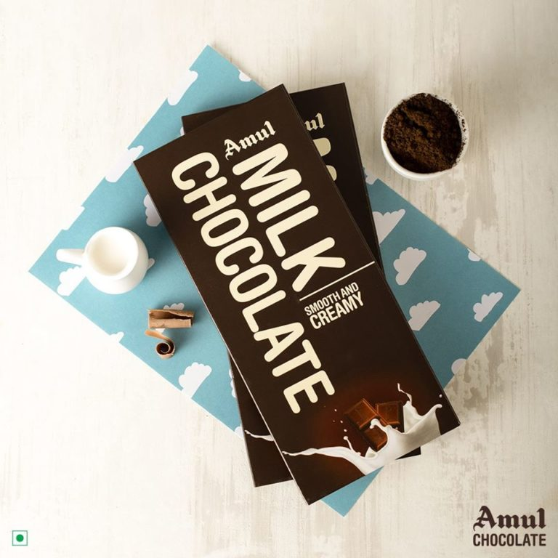
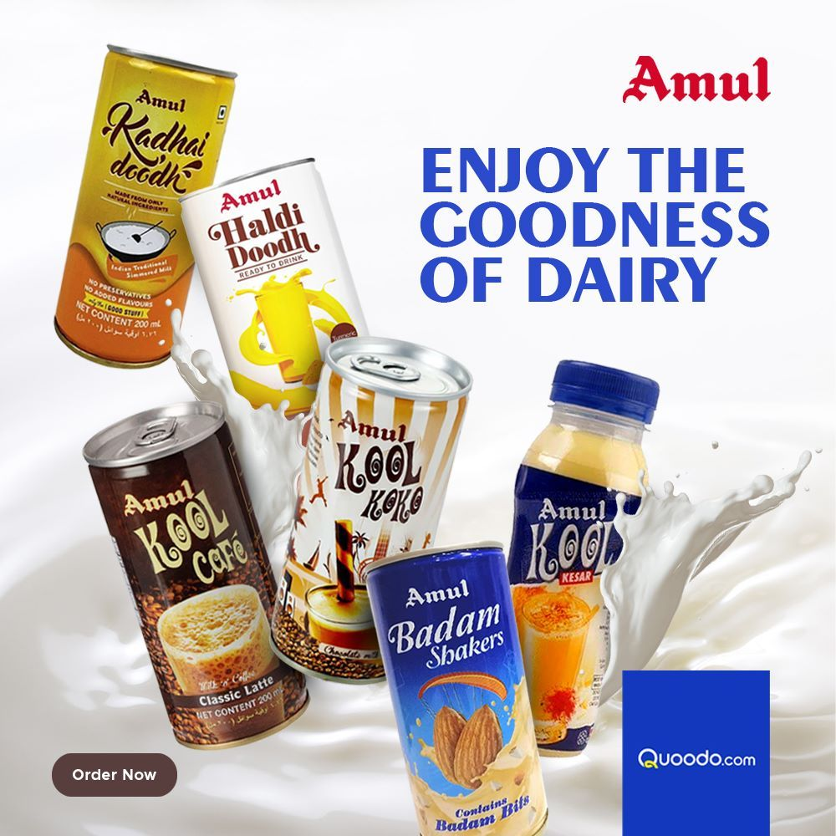
CHOCOLATE & CONFECTIONERY
• Amul Milk Chocolate
• Amul Fruit & Nut Chocolate
• Amul Eclairs
BROWN BEVERAGE
• Nutramul Malted Milk Food
MILK DRINK
• Amul Shakti Flavoured Milk

Slide 21
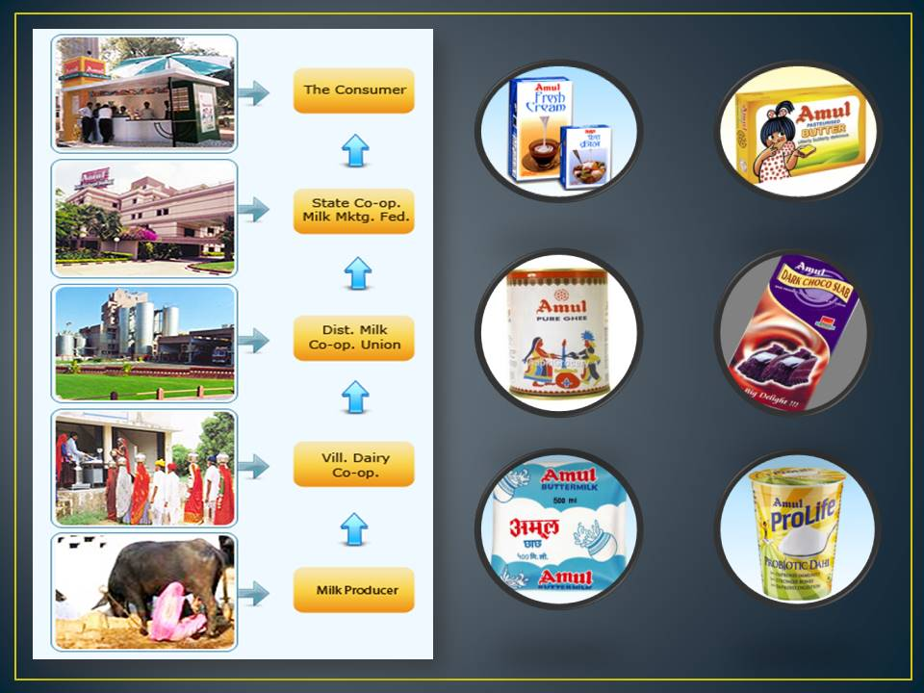
Amul’s Target Audience
Amul has targeted the mass market of India with no premium offerings and works on providing the best quality products at affordable prices.
So Amul formulates its pricing policy on the low-cost price strategy which has attracted a lot of customers in the past and it continues to do so.
Now let us understand Amul’s target audience based on customer-wise targeting and industry-wise targeting.
Their strategy divides the target audience on the following two bases:
Customer-Based target Audience
Customers | Amul Products
Kids | Chocolate, Amul Kool, Amul Milk
Youth | Amul Pizza Cheese, Cheese spread
Health Conscious | Amul Shakti, Amul Lite Butter

Slide 22
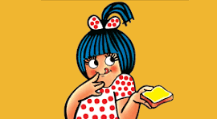
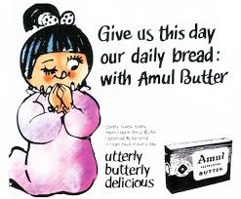
AMUL’S MARKETING CAMPAIGNS & STRATEGY
In this section, we would go through Amul’s social media marketing strategy and campaigns implemented by them.
1. The Story of the Amul Girl, India’s Most Loved Ad Icon
Amul Girl is the official mascot of the Amul brand. It is a hand-drawn cartoon of a young Indian girl dressed in a polka-dotted frock with blue hair and a pony tied up.
The Amul Girl was created as a response to Amul’s rival brand Polson’s butter-girl back in 1967. It has made a world record for the longest run ad campaign that ever happened on planet earth!
The Amul Girl was created as a response to Amul’s rival brand Polson’s butter-girl back in 1967.

Slide 23
Amul’s Digital Marketing Strategy
In this increasingly digitized world, every brand needs to revamp its marketing strategy. Amul too has cut down its expenditure on TV Ads and has started focusing more on the online form of advertising just like its competitors.
Amul on Facebook & Instagram
In the present day, The shift from offline to online marketing was fairly an easy task for Amul. They were already creating content for banners and newspapers previously and now they just follow the same style for their creatives on Facebook & Instagram as well.
Their most popular creatives on Facebook and Instagram revolve around the Amul Butter Girl the buzz-worthy happenings all around the world.
Let’s now take a look at some of Amul’s digital marketing campaigns which were a hit on Facebook as well as Instagram.
“Eat Milk with Every Meal”
In 2013, Amul hired a digital marketing agency called Draftfcb Ulka to come up with a campaign for the digital space as well as print.
The objective of this campaign was to educate Indian buyers about the goodness of milk and its byproducts.
In older times milk was considered the world’s favourite energy drink but in the present era of junk food, the importance of milk has been undermined.

Slide 24


AMUL ADS FOR INSTAGRAM AND FACEBOOK

Slide 25

NATIONAL MILK DAY CAMPAIGN
On 26th November 2018, Amul celebrated National Milk Day by launching a new campaign by using hashtags like,
#CelebratingDrKurien #BikeRally #VaranasitoAnand and # 26 November.
The objective of this campaign was to connect with the youth and inspire them to be purpose-driven and motivated in their lives.
During the campaign, Amul organized a bike rally in which 50 bikers travelled from Varanasi to Anand (2500 Kms) to meet dairy farmers, dairy professionals and to learn about Dr Kurien and his works.
Amul also launched a small 70 seconds film on Dr Kurien on Facebook, Instagram & YouTube. It also went Live on all the above-mentioned platforms to record the 12-day journey.

Slide 26
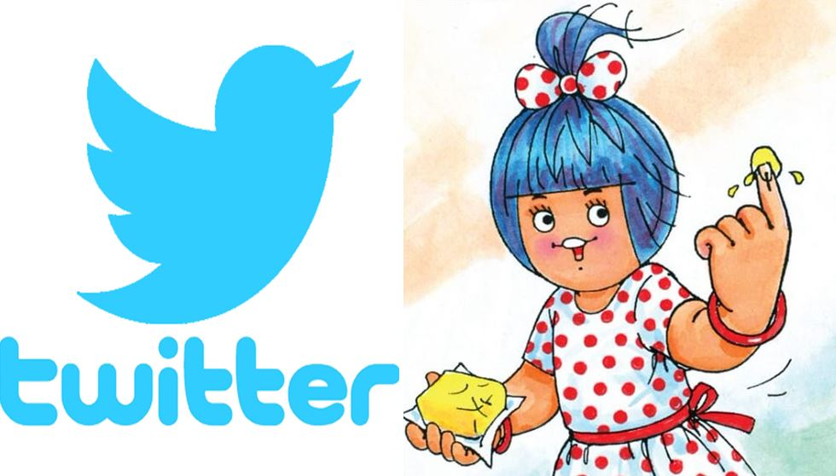
AMUL ON TWITTER
On Twitter, Amul has a massive fan base of over 335K followers given that Twitter is a very different platform when compared to other social media platforms.
On various occasions, Amul posts fun graphics featuring the Amul Butter Girl. Many people connect with those graphics and retweet them to show how they feel about the latest happenings in the world.
Twitter is a great platform for a brand to engage with its customers. Taking advantage of this, Amul tries to conduct interactive activities like contests and giveaways.
A lot of people also use Twitter to express their grievances for a service or a product. Amul makes sure that it replies to tweets of customers complaining about its products.
Unlike many brands that ignore or delete the negative posts of their customers, Amul takes the opinions of its customers very seriously and makes an effort to resolve their customers’ problems on Twitter even in the presence of thousands of people.

Slide 27
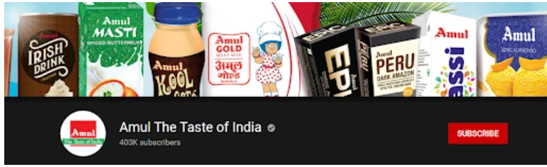
AMUL ON YOUTUBE
Amul is also present on Youtube and it enjoys about 4,03,000 subscribers on its official youtube channel called, Amul The Taste of India. However, On Youtube, it puts out advertisements that are previously aired on television.
Although, during the Covid-19 pandemic when the country was in lockdown, Amul started a new campaign called Simple Home Made Recipes that was also promoted as “#SimpleHomeMadeRecipes”.
More about this campaign will be covered in the next section of the case study. So this is how Amul’s digital marketing strategy has played out.

Slide 28
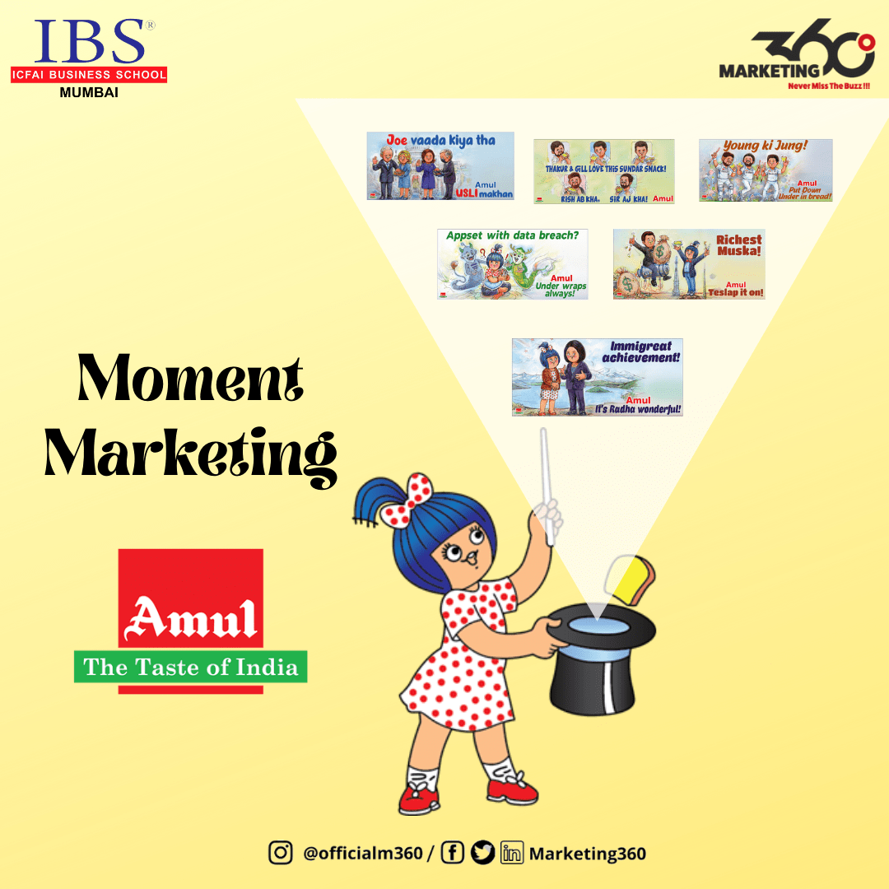
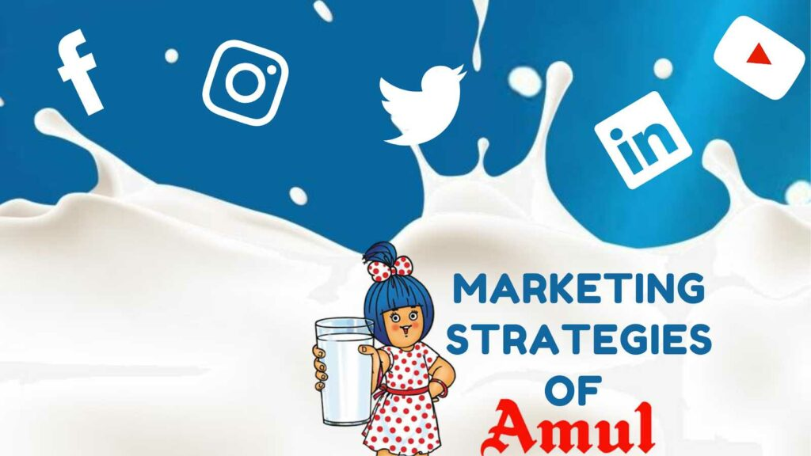
E-MAIL MARKETING
The brand regularly sends newsletters and promotional emails to its customers, providing updates on new products, special offers and product launches. Through this channel, Amul ensures that its customers are well-informed about its offerings and remain engaged with the brand.
LINKEDIN
The LinkedIn summary, also referred to as the LinkedIn bio or LinkedIn about section, is a few paragraphs of text that appears right before a LinkedIn user's list of current and prior roles. LinkedIn gives a limit of up to 2,000 words

Slide 29
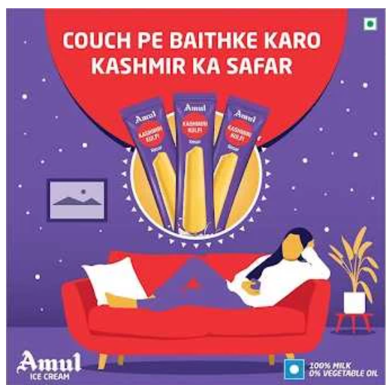
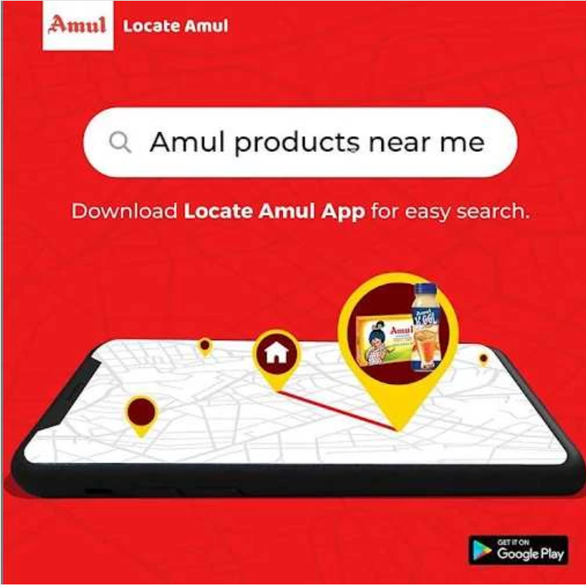
Amul’s Digital Marketing Strategies During Covid - 19
Despite the lockdown and Amul also being an FMCG brand, sales have increased due to excess consumption of households during the lockdowns and its presence on E-commerce sites like Grofers, Big Basket, Paytm mall, etc. However, it has also doubled its spending on its marketing efforts.
During the lockdown, everyone avoided stepping out of their homes and even if they did, nobody wanted to travel too far for their food supplies and put their safety at stake. So Amul went one step ahead and created an App to help its customers locate Amul products near them.

Slide 30
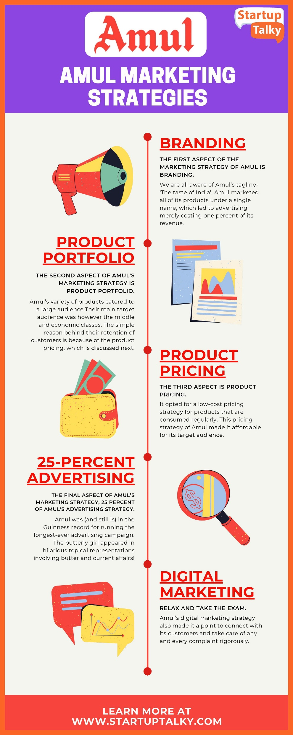
Amul's Branding as 'The Taste of India' & Amul Girl as Mascot
The first aspect of its marketing strategy of Amul is branding. What has primarily led to the Success of Amul is undoubtedly its Branding strategies. We are all aware of Amul’s tagline- ‘The taste of India’ which is a reflection of the brand's commitment to providing consumers with authentic and delicious dairy products.
The tagline banished the notion that bread and butter are a staple of only the British breakfast and pulled nationalism in.
Amul’s Product Portfolio adds to its Marketing Strategy
The second aspect of Amul's marketing strategy is its product portfolio. Amul's product portfolio includes a wide range of dairy products, including butter, cheese, milk, ice cream, yogurt, and more.

Slide 31
Amul's Low-Cost Pricing Strategy
The third aspect of Amul marketing strategies is its product pricing. It is one of the best promotional strategies adopted by Amul. It opted for a low-cost pricing strategy for products that are consumed regularly. This pricing strategy of Amul made it affordable for its target audience.
The 25 Percent of Amul's Advertising Strategy
We reached the final aspect of Amul’s marketing strategy, 25% of Amul's advertising strategy. Without advertising, the target audience wouldn’t be aware of the existence of the product.
Digital Marketing Strategy of Amul
While not as big a presence in television ads as it used to be, the advertising strategy of Amul through digital marketing has played a crucial role in expanding its reach and engaging with consumers across different platforms.
Amul's digital marketing strategy is its social media presence. The brand has a strong presence on platforms like Facebook, Twitter, and Instagram, where it shares engaging content that highlights its products and promotes its brand values.

Slide 32
CONCLUSION
Amul’s digital marketing strategies have played a pivotal role in establishing the brand as a household name and connecting with consumers in the digital landscape.The creative and innovative approach taken by Amul in their digital marketing initiatives has propelled them to new heights of success.
Amul’s digital marketing strategies have effectively utilized various online platforms to engage with their audience.Through social media channels like Facebook, Instagram, and Twitter, Amul has created a strong online presence and interacted with consumers in a personalized and engaging manner.Their social media campaigns have been a hit, capturing the attention of users and generating a buzz around the brand.
Through their creative and innovative approach, Amul has effectively utilized social media, influencer marketing, content marketing, and e-commerce to connect with consumers and reinforce their position as a trusted and beloved brand.
As Amul continues to evolve in the digital age, their digital marketing strategies will undoubtedly play a crucial role in shaping the brand’s future and further solidifying their presence in the hearts and minds of consumers.

Slide 33


